Slide 1
COVID-19 PSS Response Webinar
2 March, 2020

Slide 2
Agenda
COVID-19
Introduction
Hong Kong Red Cross MHPSS responses during COVID-19 - Eliza Cheung, PSS Service, Hong Kong Red Cross, Technical Advisor, IFRC PS Centre
Japanese Red Cross Society’s Cruise Ship Operation - Musubi Yata, Officer, International Relief Division, Japan Red Cross Society
Canadian Red Cross MHPSS responses to those in quarantine - Sarah Sargent, Vice President, Programs Canadian Operations and Esmé Lanktree, Health Advisor, International Operations Canadian Red Cross
MHPSS considerations and recommendations for National Societies’ interventions for different target groups - IFRC PS Centre, Ea Suzanne Akasha, technical adviser
Discussion and Wrap Up

Slide 3
Introduction
COVID-19
Last week, hundreds of tourists quarantined at H10 Costa Adeje Palace hotel in Spain
Early February, thousands quarantined in cruise ships in Hong Kong and Japan
Such measures are becoming a more frequent part of the global response to COVID-19
The psychosocial wellbeing of individuals and families in such situations can be deeply affected
NS providing PSS as part of their COVID-19 response → opportunity for knowledge sharing

Slide 4
MHPSS response in COVID-19 in Hong Kong
Eliza Y. L. Cheung
Service in-charge, Psychological Support Service,
Hong Kong Red Cross
Technical Advisor, IFRC Reference Centre for Psychosocial Support, IFRC

Slide 5
situation update in Hong Kong SAR
2 March 2020
Number of confirmed cases | Number of confirmed cases Number of deaths among confirmed cases#
100 | 2

Slide 6

Direct PFA sessions
By Phone
By Video counseling via Zoom
Local Hong Kong people
Hong Kong people overseas, eg. Diamond Princess Cruise
From social unrest to disease outbreak

Slide 7
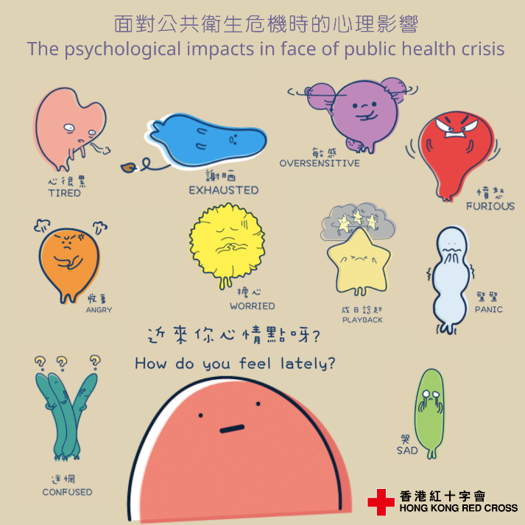
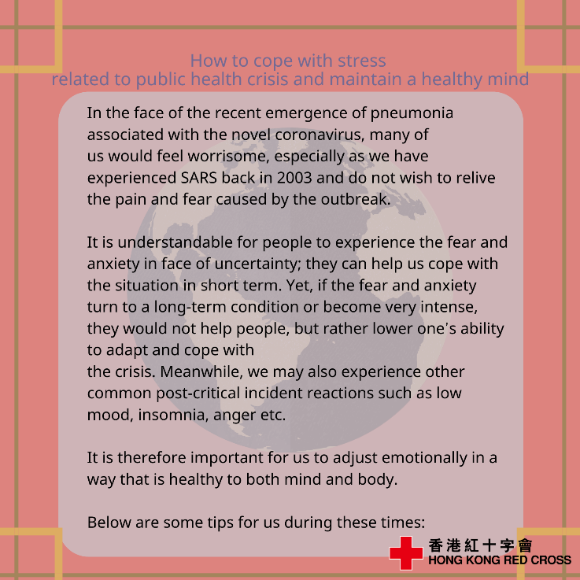
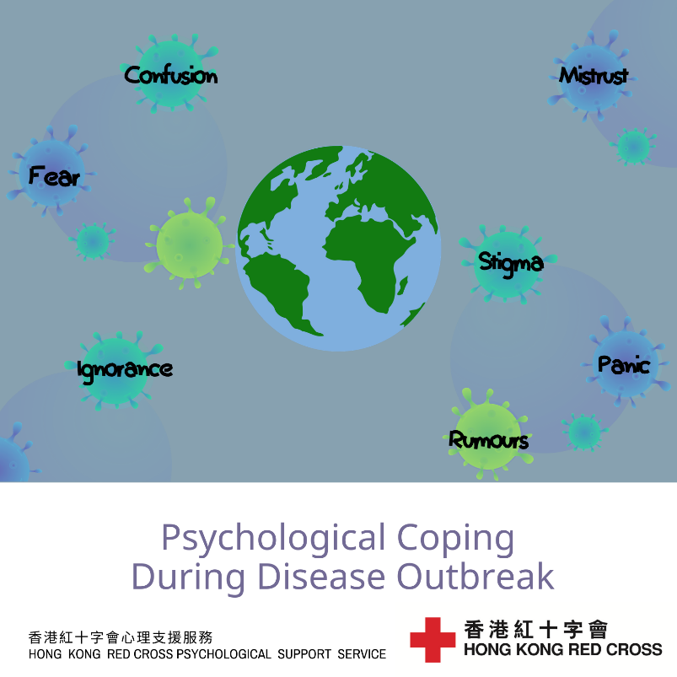
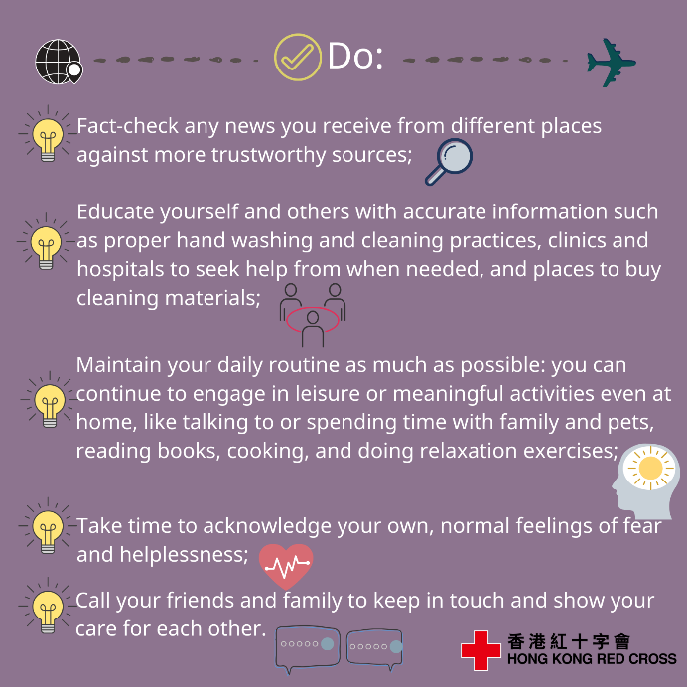
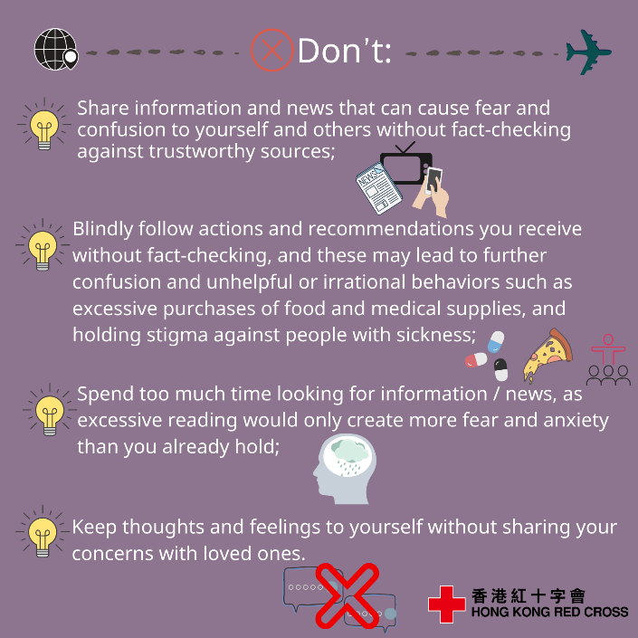
Development of MHPSS IEC materials
For General public

Slide 8
Development of MHPSS IEC materials
For People under quarantine
For Elderly and people with chronic conditions

Slide 9
For healthcare and first responders

Slide 10
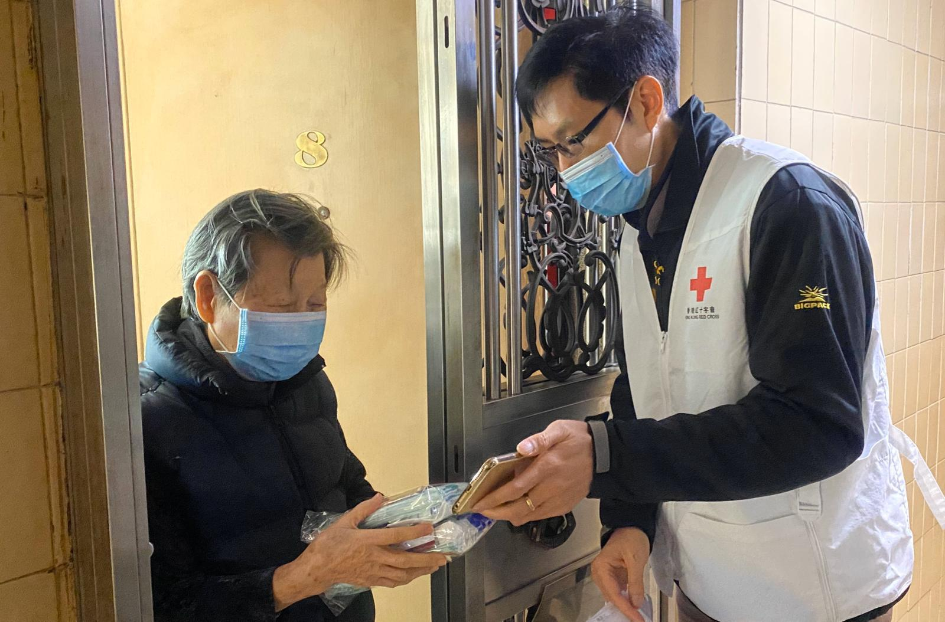
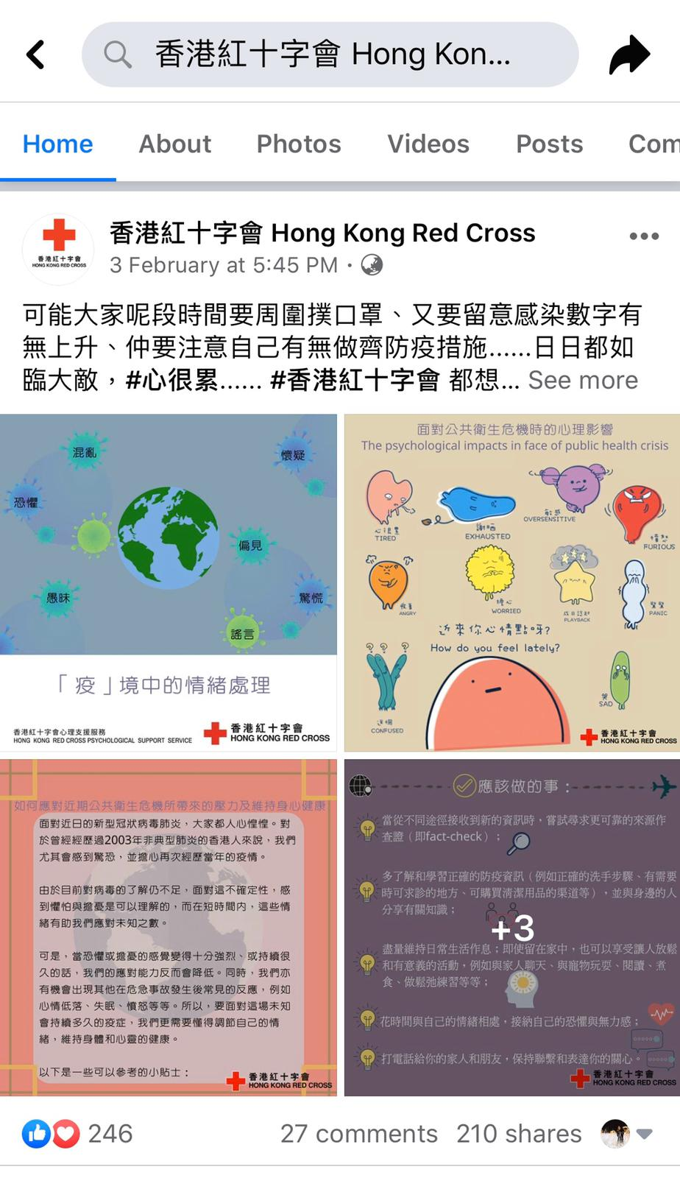
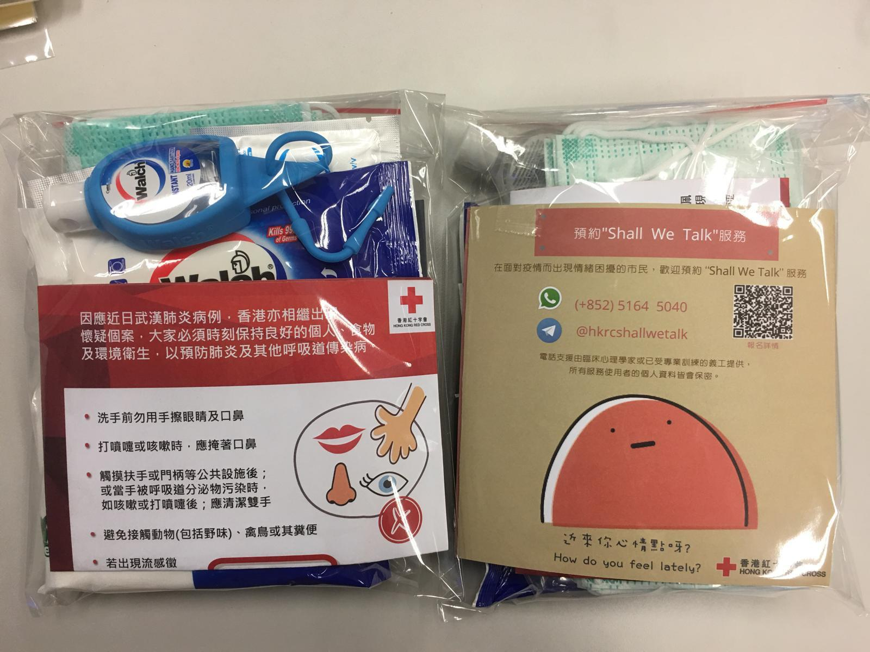
Distribution of MHPSS IEC materials

Slide 11

Translation of MHPSS guide into Chinese

Slide 12
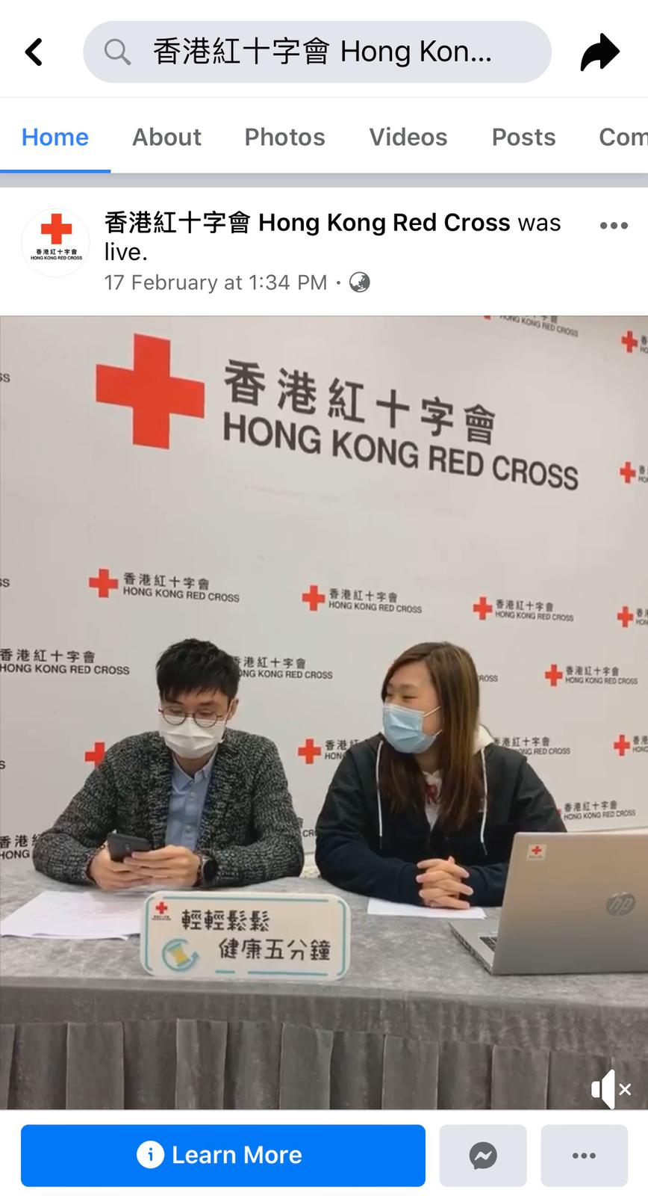
Facebook live to deliver MHPSS messages to public

Slide 13
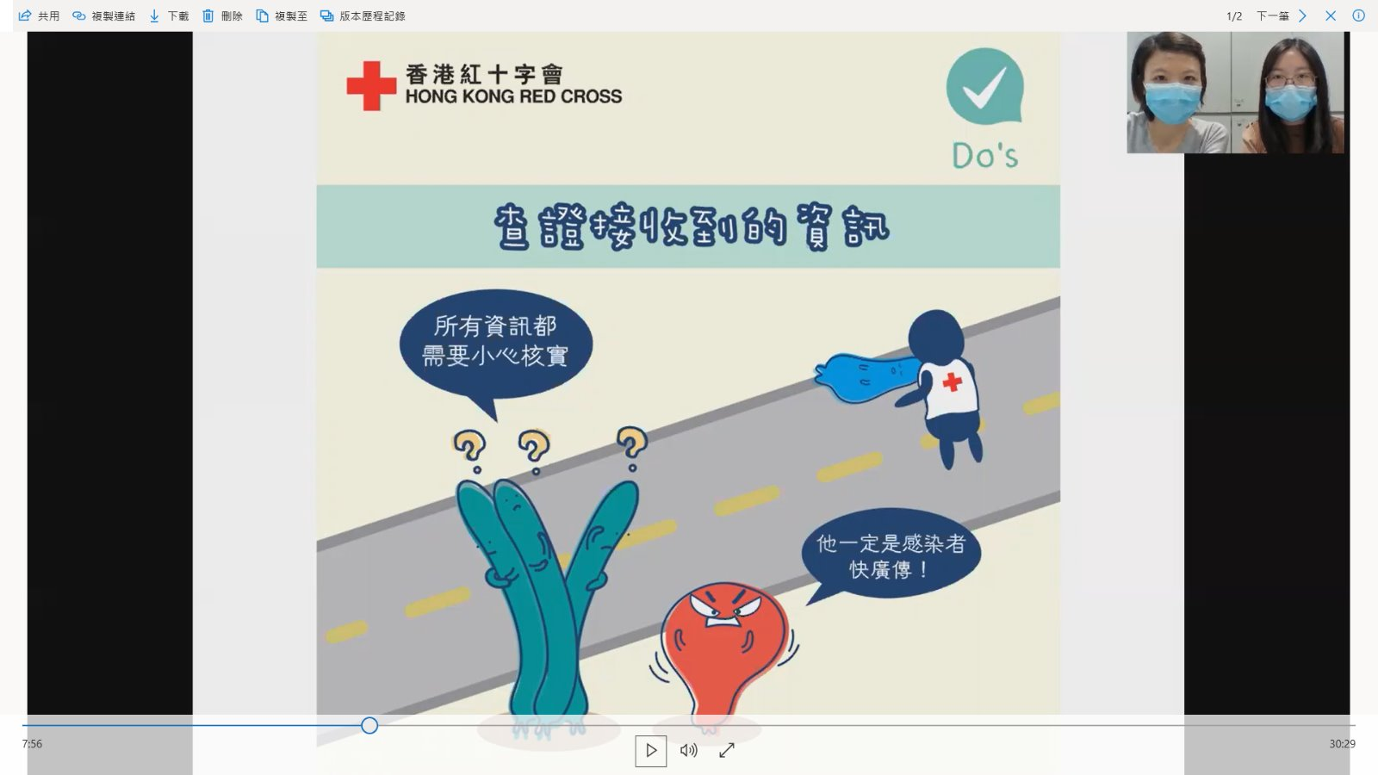
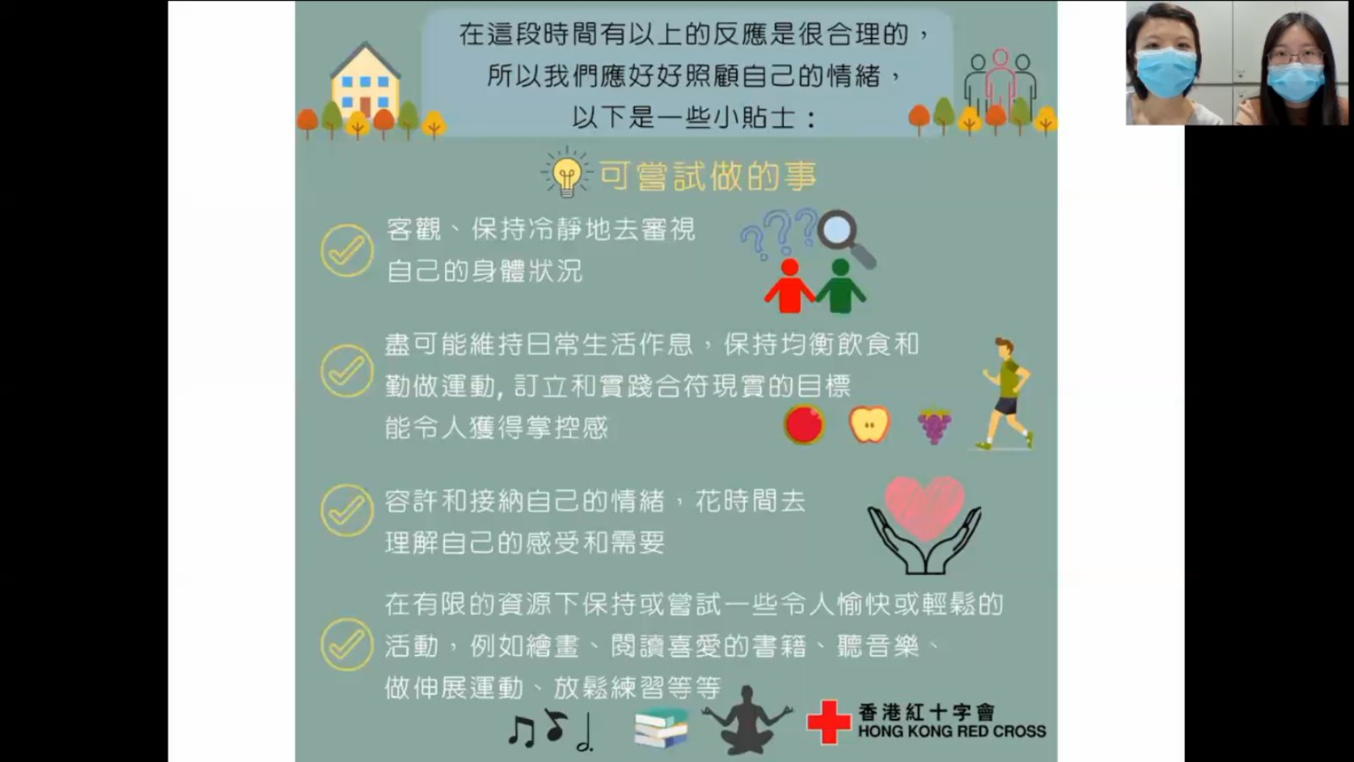
Recording MHPSS seminar for middle and high school students to learn from home (suspension of school from end of Jan to mid April)

Slide 14


Japanese Red Cross Society’s Cruise Ship Operations
Situation: Feb 3rd-Mar 1st
-2,700 passengers and 1,000 crew were on the cruise ship at port of Yokohama.
First cases were found on Feb 3rd. The infection was widely spreading inside the ship and 705 people were confirmed positive (as of Feb 29th).
-Following the request of the Ministry of Health, Labour and Welfare (MHLW), the JRCS dispatched its Medical Relief Teams to the cruise ship for supporting medical examination in the medical center inside the ship from February 10th to February 26th.
-By Mar 1st, all people on board got off from the ship.
Those who tested positive are under the medical treatment in hospitals in Japan.
©Asahi Shinbun

Slide 15
Japanese Red Cross Society’s Cruise Ship Operations
Difficulties:
-Language Barrier: Almost 70% are foreigners from 56 countries.
-High risk of being contaminated
-No Face to Face communication/ No touching
©Asahi Shinbun

Slide 16
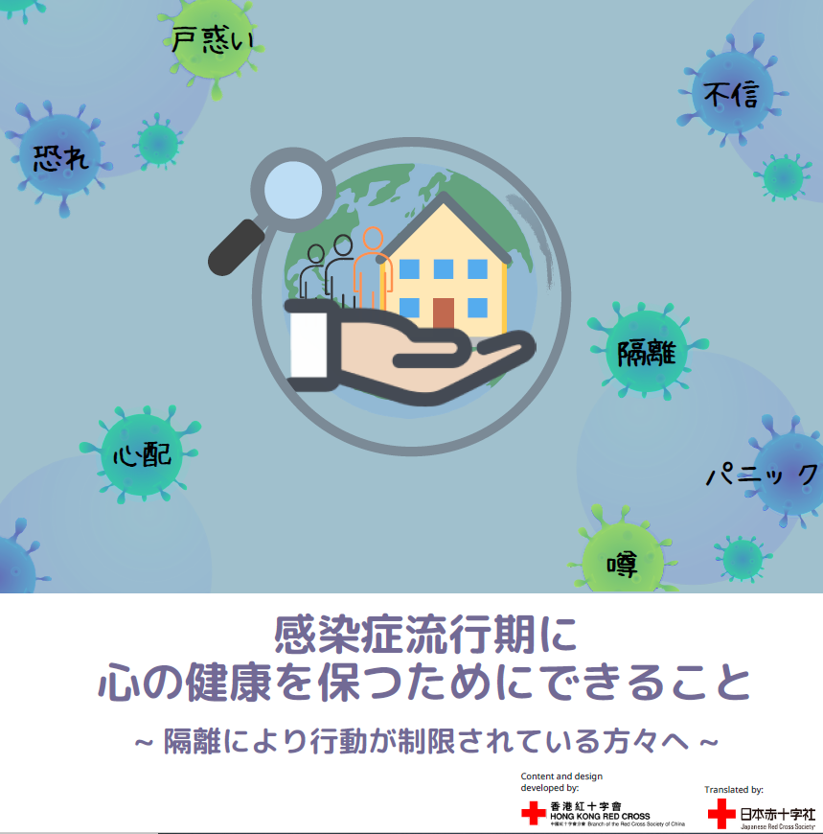

Japanese Red Cross Society’s Cruise Ship Operations
What we’ve done
-Distribution of PSS leaflet (English, Chinese, Japanese) to Passengers and Crew in the cruise ship
JRCS translated the PSS leaflet “Psychological Coping during Disease Outbreak” developed by HKRC, the branch of RCSC.
In collaboration with Disaster Psychiatric Assistance Team and the Japanese Government MHPSS Team, we distributed this leaflet to all the passengers and crew via digital device (iPhone) provided by the Japanese Government on February 18th.

Slide 17
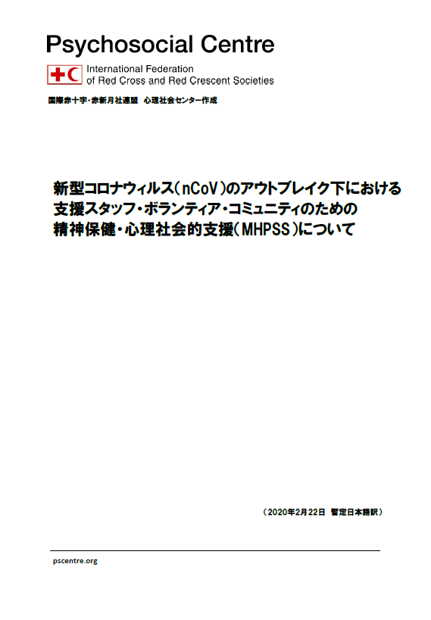

Japanese Red Cross Society’s Cruise Ship Operations
What we will do
-Staff MHPSS (not only for the cruise ship)
The JRCS has been providing PSS with the Emergency Medical Team members after they came back to their own hospitals from the mission. Since stressors particular to COVID-19 outbreak may affect them and their environment around.
The JRCS developed a MHPSS task force team especially for Red Cross MHPSS staff.
We translated “Mental Health and Psychosocial Support for Staff Volunteers and Communities in an Outbreak of Novel Coronavirus” into Japanese, and distributed it to Red Cross hospitals whose staff were involved in Medical Relief operations at the cruise ship and quarantined facilities.

Slide 18
Japanese Red Cross Society’s Cruise Ship Operations
What worked well
-Collaboration with the Government Team (DPAT)
-Relevant and high quality resources were provided timely from Red Cross and Red Crescent network
-(now we are working) Since this infectious condition was really challenging, we have been paying close attention to “Staff care” from the beginning.
What could be improved
-Different authorities and command:
Timely and appropriate services would have been provided if we should have understood reporting line and related authorities in such difficult situation..
-Innovative PFA approach without “Look”, “Listen”

Slide 19

Canadian Red Cross MHPSS responses in Canada
& Japan
following COVID-19 outbreak
Sarah Sargent
Vice President, Programs - Canadian Operations and
Esmé Lanktree
Health Advisor - International Operations

Slide 20
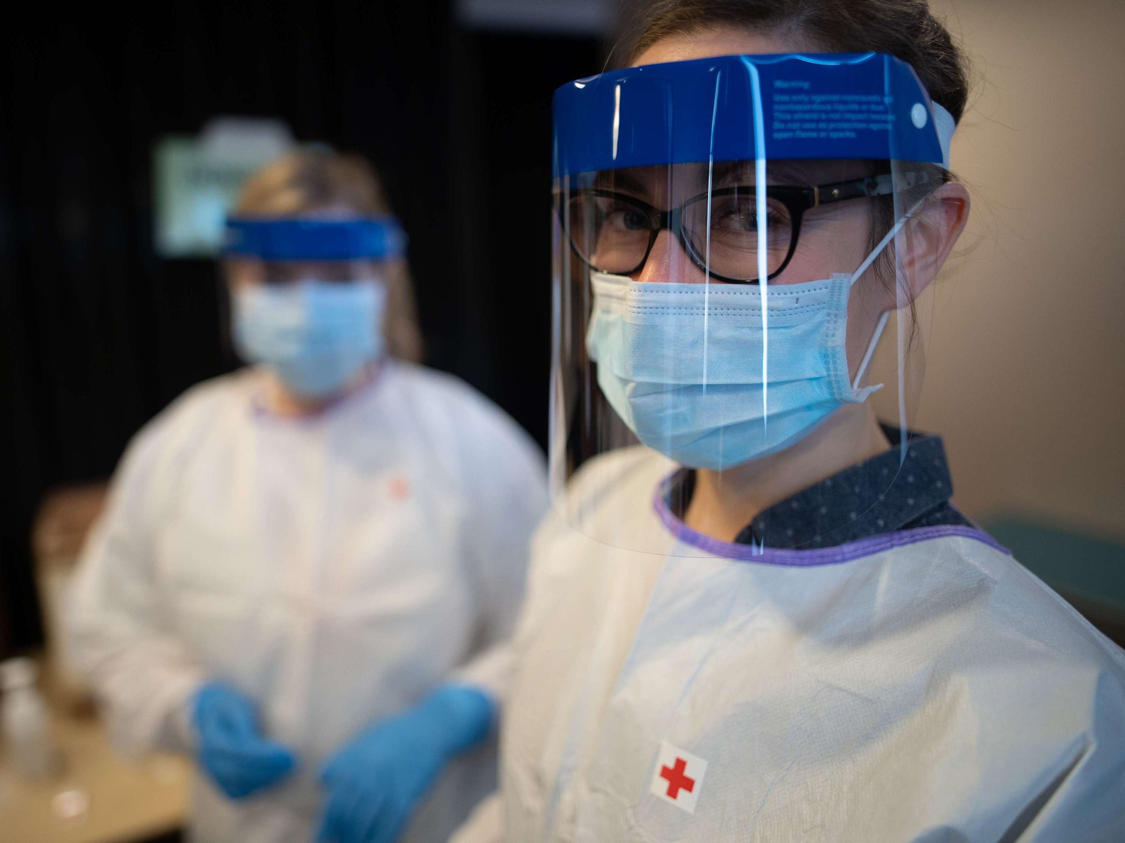

Slide 21
MHPSS responses with nationals during and after quarantine in Canada
Providing PSS to travellers in quarantine via phone and face to face interactions
Conducting regular wellbeing checks for travellers requiring emotional support
Connecting travellers to existing resources including recreational items
Managing escalations for travellers requiring additional PSS
Providing referrals for travelers requiring additional face to face MHPSS available on-site
Identifying and supporting travellers who may experience difficulties upon released from quarantine
Coordination with local MHPSS agencies to ensure effective referral pathways and non-duplication of services.

Slide 22
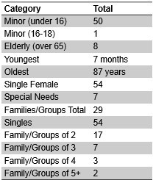
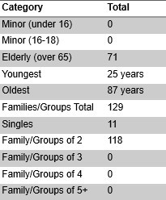
Trenton and Cornwall Response demographics

Slide 23


Summary
MHPSS Response in Canada
Stats from Feb 27th | Total to Date
 | Trenton | Cornwall
Total # of Beneficiaries contacted by CRC with PFA | 304 | 289
Total # of Internal Referrals to Safety and Wellbeing | 46 | 44
Total # of External Referrals | 60 | 12
Total # of Beneficiary Protection Cases | 2 | 2
Total # of meetings with MHPSS sector agencies | 4 | 4

Slide 24


Slide 25
MHPSS responses with Canadian nationals in Japan
CRC, at the request of the Government of Canada, and in coordination with the Japanese Red Cross, has sent a team to Japan to support Canadians being treated or in isolation for COVID- 19 in Japanese hospitals and their families.
Team deployed includes medical liaison delegates and psychosocial support delegates
No direct contact with those being hospitalized

Slide 26
MHPSS responses with Canadian nationals in Japan
Examples of challenges for those currently being supported:
  Confined feeling, as in isolation for several weeks
  Difficulties communicating with hospital personnel (i.e. language barrier)
  Difficulty to adapt to different culture, food, etc.
  Distrust of health system
Activities:
  Ongoing dialogue through telephone check ins with those in isolation and family members (Multilingual)
  Food (warm meals) for patients
  Decreasing isolation through improving communication
    Patients received phones with Whatsapp

Slide 27
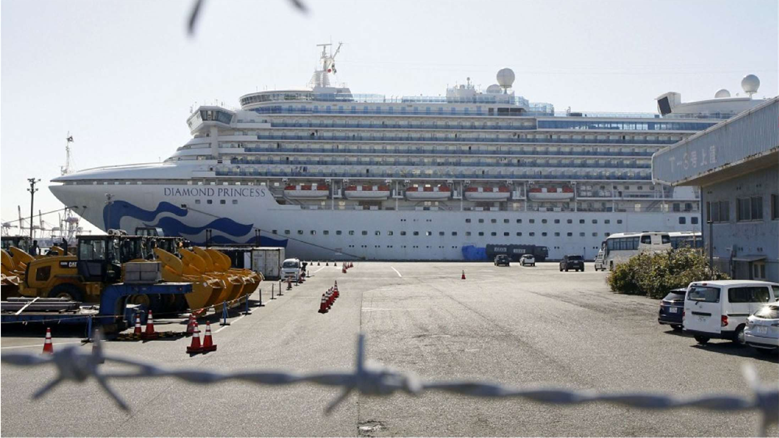
Photo from KYODO NEWS
Questions?

Slide 28
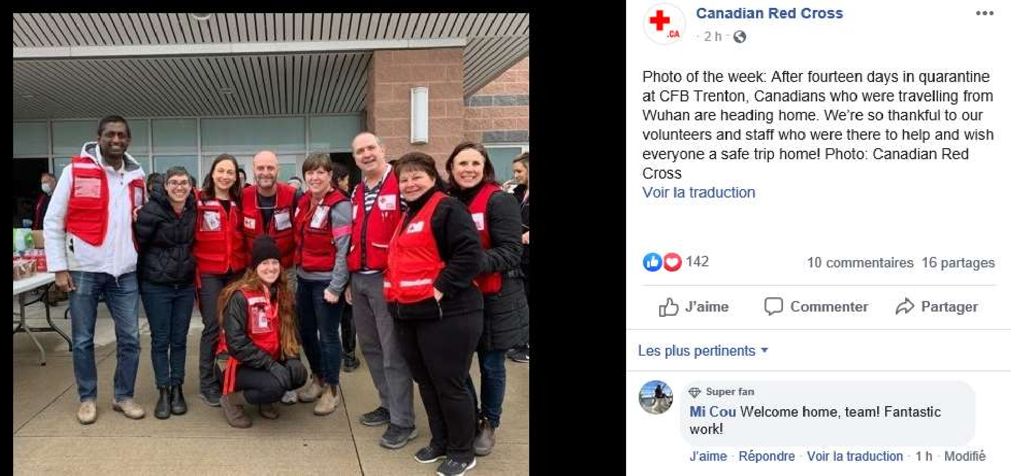
Thank you!

Slide 29
MHPSS INTERVENTIONS IN COVID-19
Ea Suzanne Akasha, technical adviser, eaaka@rodekors.dk
What National Societies can do for different target groups:
The general public
Volunteers and those engaged in face to face activities
Volunteers and beneficiaries with no face to face activities
Volunteers offering remote supports as hotlines
Volunteers + others - after a response
Notes:
The capacities of health authorities and health systems in each country are different and so is the role of each NS differs as an auxilliary organisation.
MHPSS messages that the Red Cross Red Crescent can share with the general public – this is due to the reason that most Health authorities are giving out good solid info, however in many countries there is a need for additional MHPSS info. (influencers could be used here)
MHPSS information and messages from RCRC to volunteers
Those that are engaged in activities
Those that conduct daily – wellbeing calls to (very often ) older and isolated people + Those that will be on hotline calls
MHPSS from RCRC to those in isolation/quarantine
FINALLY support to volunteers + others involved in the response

Slide 30
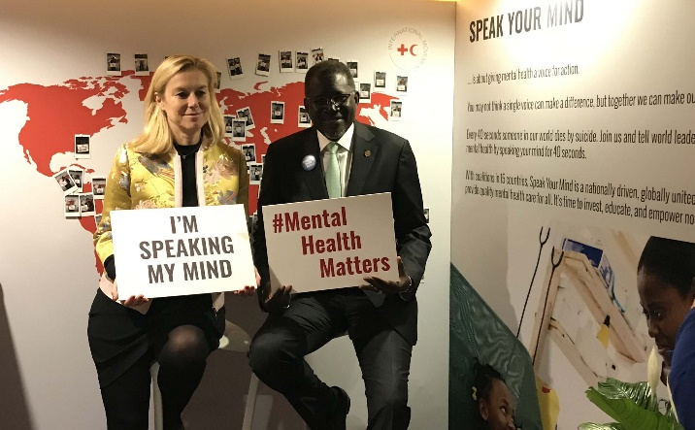
Principles for MHPSS in humanitarian settings
All interventions should promote a feeling of:
Safety
Calming
Self and collective efficacy
Connectedness
Hope
Notes:
Known as the Hobfoll five, these principles are based on many studies in what helps in disasters/humanitarian settings to avoid mass trauma.
The research article is called: Five Essential Elements of Immediate and Mid–Term Mass Trauma Intervention: Empirical Evidence (Hobfoll et al.)
The article is fon pscentre.org https://pscentre.org/?resource=five-essential-elements-of-immediate-and-mid-term-mass-trauma-intervention-empirical-evidence-hobfoll-et-al

Slide 31
MHPSS CONSIDERATIONS AND MESSAGES
FOR THE GENERAL PUBLIC
Epidemics are stressful
Stress clouds thinking and leads to emotional overload
Epidemics bring out fear of real and imagined risks and lots of false information
Mass communication through SoMe can bring correct information on COVID-19 and MHPSS advice and knowledge
Knowing what to do to be prepared and stay safe gives a sense of control and helps manage fear. This builds capacity to cope better in adversity
Notes:
When stressed, your thinking is clouded and you dont realize your thinking is clouded because you are stressed
Messages though some, website, newsletter and through other media campains as sending out txt messages can be very helpful if coming from a trusted source
Messages can normalize worry and at the same time assist in creating a feeling of safety, calming, self and collective efficacy, connectedness and hope
Use influencers as Red Cross Red Crescent ambassadors, presidents or others who are known in country and who has many followers
As having access to correct information is helpful and minimizes stress
This will help prevent the stigma that is linked to covid-19 and promote inclusion

Slide 32
MHPSS CONSIDERATIONS AND MESSAGES
Volunteers with face to face contact
Volunteers can:
disseminate key messages when interacting with people during activities
provide updated and correct information
use MHPSS skills on handling concerns ( should be trained in psychological first aid)
know how to encourage positive coping and teach calming techniques
discuss how best to prepare for this or other similar outbreaks
Notes:
Volunteers are key in behavioural change as they interact with many during activities
One very concrete example is that at the beginning af meetings or activities whether conducting a group for bereaved, opening a recycling shop for the day, having a branch meeting on a topic or a first aid training – go over the general advice and precautions on covid-19. wash hands together…
Post useful advice in windows and offer info-leaflets if running a second hand shop
Discuss rumours – which outrageorus rumours have you heard recently (humour works well!)– and where to get correct and updated information.
Give simple advice on how to stop rumination and constantly looking for information, discuss useful calming techniques – step one acknowledge the situtation… then doing what calms you…
Discuss how to prepare for situations where someone you know could be in isolation or you and the family could find yourself in isolation. How best to structure the days, how to keep in touch
Find training materials in psychological first aid at pscentre.org – or look for the session in eCBHFA
If running activities for children show pictures of protective gear and explain chains of transmission etc… teach them about feelings, how they change and how to calm oneself
Instruct caregivers to be mindful of how to talk, when and when not to talk in front of children – take their worries seriously and teach them to put worry aside – this is postive coping for children

Slide 33
MHPSS CONSIDERATIONS AND MESSAGES
Volunteers with no face to face contact
Volunteers doing well-being and care calls:
can inquire into what is known about COVID-19
ask about concerns and offer information
discuss which sources of information the person usually uses and which could be better sources
inform about possible solutions should a situation of concern arise:
  when to call the health authorities
  How to get food delivery if not connected to the internet or if no delivery takes place in the area
  Discuss support options in the neighbourhood also for the recipient to help others
Notes:
Some NS have well-being and care telephone supports where a volunteer call an older or lonely person on a daily basis during weekdays
The basic principles used here are the same as before –
INFORMATION AND KNOWLEGDE Discuss and offer correct information
Help the recipient anticipate what to expect –and how best to cope emotionally in stressful situations. Realizing and naming one’s emotion is in itself helpful and assists in managing stress
Plan what to do if a situation arises
Use the same techniques to stop worrying and limit time looking for information

Slide 34
MHPSS CONSIDERATIONS AND MESSAGES
Volunteers offering remote supports as hotlines
Volunteers on hotline or doing support calls to those in isolation can offer supports on how best to manage:
Keep in touch with family, friends and colleagues
Create a plan for the days - especially important for children
Be physical active
Do stress reduction activities
Read, study, write poems
Create a list of ideas of what people always wanted to do: spring cleaning, planning, drawing, sewing, cooking, knitting, write an autobiography or a thriller
And listen to moaning and refer to other services if needed
Notes:
When being on a hotline or offer daily calls to someone in isolation, a new relation is established and the situation differs from that of those doing daily well-being and care calls.
Key elements are to 1.
When communicating by phone/IT with or without visual contact, Precise verbal communication is very important, slow down o ensure being understood, communicate empathy and warmth
through the use a calm voice.
The call will then usually follow this sequence:
Introduce the caller and the Red Cross Red Crescent, explain the aim of the call, and give the time frame.
Ask how the recipient is doing
Provide accurate information on disease outbreak to promote calming
Use key psychosocial phrases to normalize reactions and to establish useful strategies the recipient has used before when faced with adversity.
Ask questions to find out if there are any concerns or if the recipient needs any other support
End the call and agree on a next call if needed
During the call, rephrase and summarize. Comment on what the recipient is doing well to manage the situation.
Volunteers can normalize the situation by giving information about normal reactions to stressful situations – its normal to be upset, sad, bored, irritated, frustrated, anxious etc.
Referrals can be to eg. psychological or psychiatric services or to faith-leaders

Slide 35

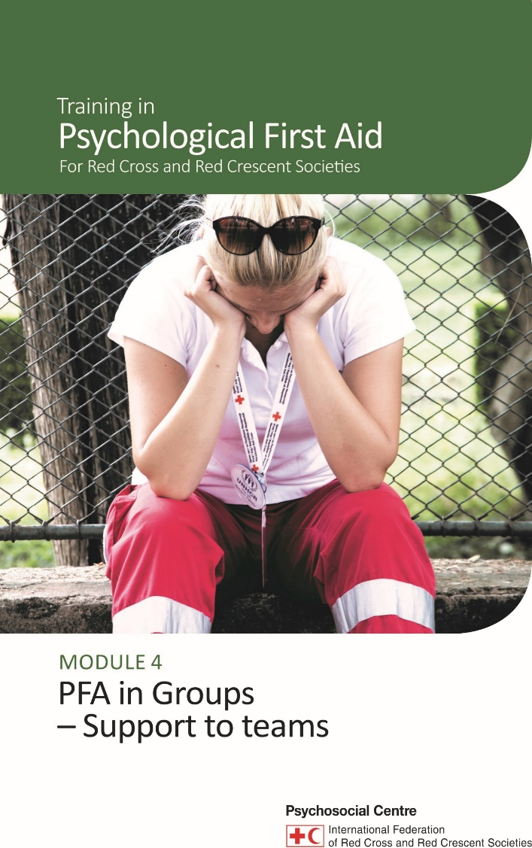
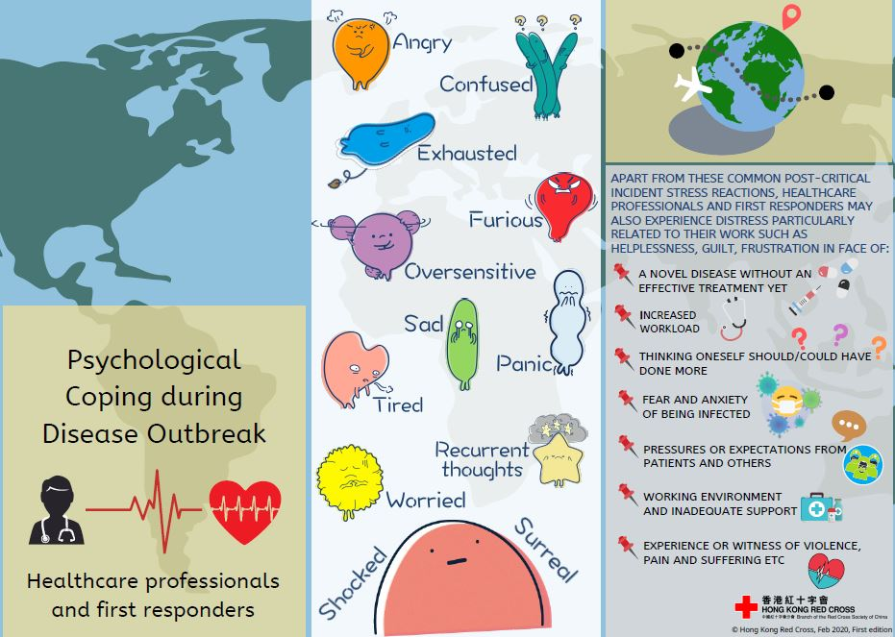

See materials on pscentre.org for providers..
Notes:
Support to staff and volunteers is an obligation!
At the PS Centre’s website there is materials for providers – and for team leaders who wants to run support meetings for teams who have faced challenging situations..
There is a good chapter on support to teams in the Guidelines for PFA for Red Cross and Red Crescent Societies and a training manual to go with it.
Or get in touch: eaaka@rodekors.dk

Slide 36

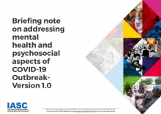
Key resources on MHPSS
Notes:
Pscentre.org

Slide 37
Discussion and Wrap Up

