Slide 1
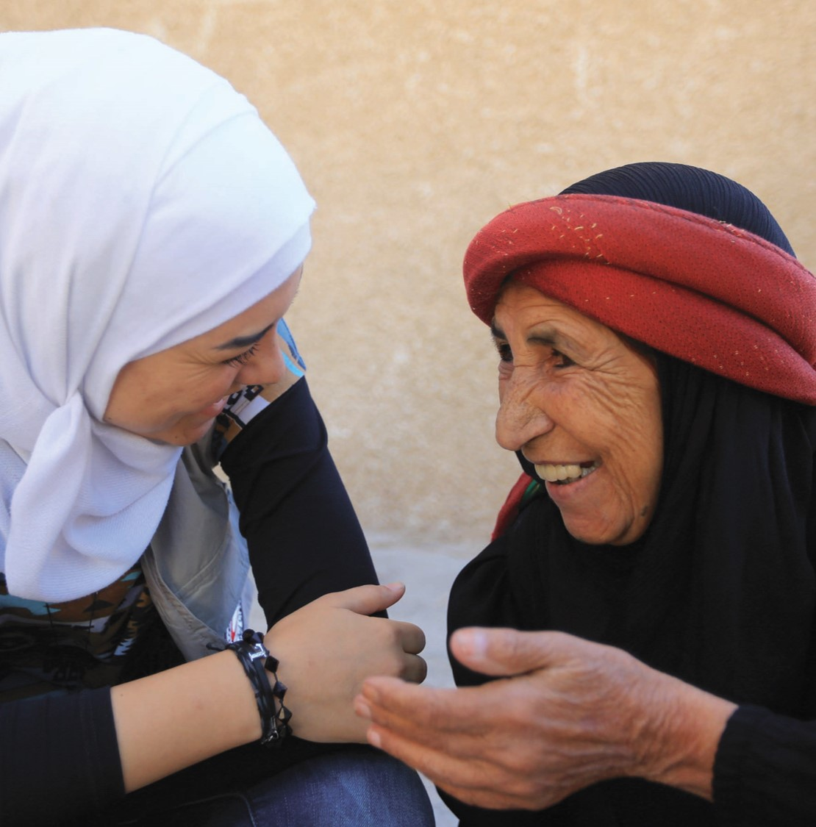
Mental health matters
  Your preferred subtitle
  Your organization’s name
  Your logo
  Or other relevant information
Notes:
SLIDE 1. Purpose of slide. i) Introduction.
Purpose of the PowerPoint Presentation
[This PowerPoint has been designed to assist National Societies in explaining the Red Cross Red Crescent Movement policy, resolution and roadmap on mental health and psychosocial support. National Societies may edit or adapt any of the images or text to fit their specific context. It is encouraged to use photos and examples from your own specific contexts.]
Title & Subtitle. Mental Health Matters
[You may also wish to include other details including: A subtitle such as ‘Mental health and psychosocial support and the Red Cross Red Crescent Movement’, your organization’s name and logo, your role, or the specific topics you will discuss – the policy, resolution, and/or the roadmap.]
Speaking notes. Present yourself, your organization, and your role and the topic. See the example below. Adapt the details.
Welcome and thank you for taking the time to be here and take part in this learning session about the Red Cross Red Crescent mental health and psychosocial support policy, resolution and roadmap.
My name is Mel Powell. I am a psychologist at the Icelandic Red Cross with experience and expertise in mental health and psychosocial support. I am also the focal point at the Icelandic Red Cross on the Movement’s mental health and psychosocial support policy.
I will lead the session today and it will take approximately thirty minutes. [Adapt the timing according to how long you plan to use]. We will have time throughout and at the end for questions.

Slide 2
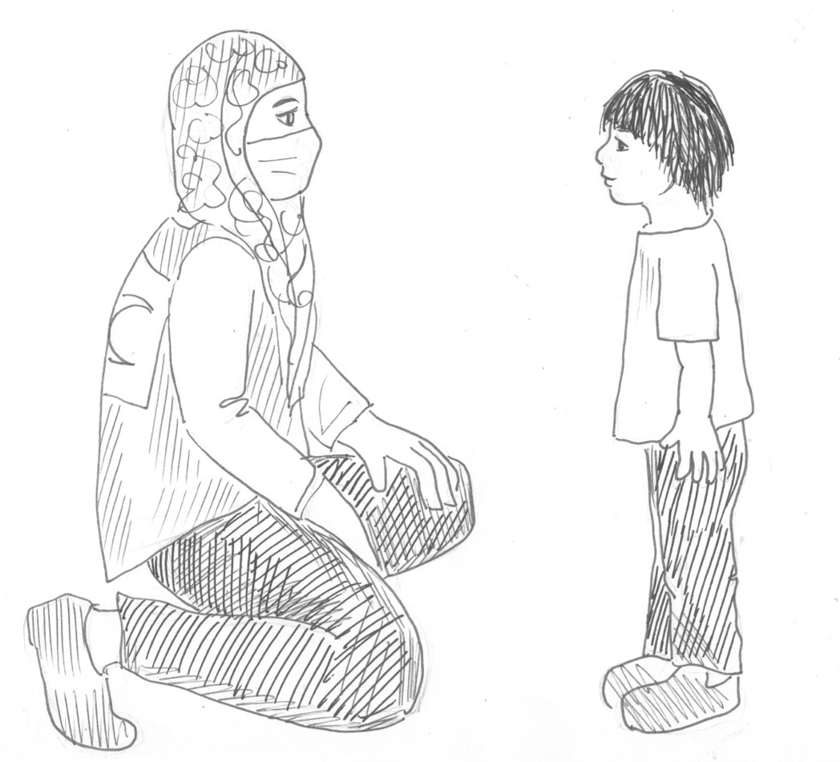
Why mental health matters
  Real, urgent and life-threatening needs
  A leading cause of disability worldwide
  80% of people with mental health
  conditions are without quality,
  affordable care
  Long term and far-reaching impacts
  Individuals, families, entire communities
  and societies affected
https://youtu.be/FDKnxU7BkG4
Notes:
SLIDE 2. Purpose of slide: i) Raise awareness of the unmet mental health and psychosocial needs; ii) Create a sense of urgency, and iii) Use statistics and graphics to support
Video options
You may wish to show a video. Below are two options developed by and for the Red Cross Red Crescent Movement on the importance of mental health and psychosocial support. Or you may use your own video on this topic.
https://youtu.be/FDKnxU7BkG4 “Let’s act together” 3 minutes
https://youtu.be/LAaI6JC5eLY ”The International Red Cross Red Crescent Movement’s commitments on mental health and psychosocial needs” 3 minutes
Speaking Notes. Adapt to your context and choose the most relevant points. You may wish to show a video instead or as well and shorten the speaking notes
Mental health and psychosocial support needs are real, urgent and life threatening.
They are among the leading causes of ill-health and disability worldwide.
Yet nearly two-thirds of people with known mental health and psychosocial needs never seek help, due to a lack of access to care and treatment, and the stigma surrounding this issue.
In 2019, WHO estimated that more than 80% of people with mental health conditions are without any form of quality, affordable mental health care.
At the same time, 800,000 people die due to suicide every year, and it is the second leading cause of death among young people.
Armed conflicts, natural disasters and other emergencies have an immense long-term impact on mental health and psychosocial wellbeing.
The rates of mental health conditions increase extensively after emergencies and especially in situations of armed conflict.
Emergencies affect or destroy community and family resources and undermine personal coping strategies and social connections, which would normally support people.
Psychosocial difficulties increase too when, for instance, people are separated from or lose members of their family or friends, living conditions become very difficult and people are exposed to violence or cannot access assistance.
It is well documented that unmet mental health and psychosocial needs have far-reaching and long-term human, social and economic impacts.
Mental health and psychosocial needs remain unmet for different reasons, including:
the strong stigma around mental health
the lack of protection of affected people
limited access to services
lack of capacity of the professional workforce, and/or
insufficient resources for, and prioritization of, mental health and psychosocial needs.

Slide 3
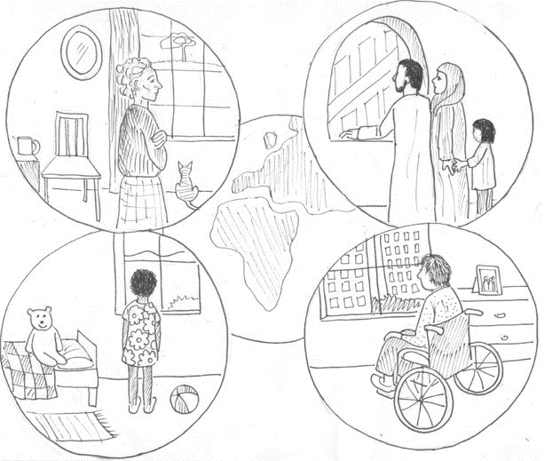
The Movement’s MHPSS commitments
A Movement Policy
  A more harmonized, holistic, integrated and contextually appropriate response
  ensure quality and provide overall guidance
A Resolution between States
and the Movement
  Scaled up collective response
  Support joint, cohesive efforts to
  address gaps
Notes:
SLIDE 3. Purpose of slide: i) Explain the reasons behind developing the MHPSS Policy and Resolution, and ii) Provide a brief introduction to the process of developing the mental health and psychosocial support Policy and Resolution
Speaking Notes. Adapt to your context.
Addressing mental health and psychosocial needs is a central part of the Movement’s broader objectives to prevent and alleviate human suffering, to protect life, health and dignity and to promote health and social welfare among individuals and communities.
Every day, volunteers and staff support communities and individuals by providing psychological and psychosocial support, promoting existing individual and community coping mechanisms, building resilience and referring people to, or providing, mental health services when needed.
The Movement saw an urgent need to increase efforts to address the extensive unmet mental health and psychosocial support needs, and therefore, in December 2019, the Movement made historical commitments and adopted a joint Movement policy on mental health and psychosocial needs in all contexts. Also, together with 196 States (the State parties to the Geneva Conventions) the Movement adopted a resolution on addressing the mental health and psychosocial needs of people affected by armed conflicts, natural disasters and other emergencies.
Both documents have been developed through an inclusive drafting and review process involving the IFRC secretariat, the IFRC PS Centre, ICRC and more than 25 National Societies.
The purpose of the policy is to contribute to an enhanced Movement response by providing overall guidance to National Societies, the International Federation of the Red Cross and the International Committee of the Red Cross on how to build a more harmonized, integrated, contextually appropriate and holistic response to mental health and psychosocial needs.
The purpose of the resolution is to recognize the urgent need to scale up the collective response to the mental health and psychosocial needs of people affected by armed conflicts, natural disasters and other emergencies. Its aim is also to support joint and cohesive efforts with States and other stakeholders to address critical gaps in mental health and psychosocial support services.

Slide 4
Policy
Resolution
  All National Societies,
  the IFRC and ICRC
  All contexts that
  the Movement works in
  A MHPSS framework,
  and eight policy statements
  All National Societies, the IFRC,
  the ICRC and States
  Exclusive context of persons
  affected by armed conflicts, natural disasters, and other emergencies
  A call for action, and emphasis
  on practical steps
Notes:
SLIDE 4. Purpose of slide: i) Give an overview of the MHPSS Policy and 33IC Resolution; ii) Describe the main similarities and differences between the MHPSS policy and resolution
Speaking Notes.
The policy and the resolution both have the goal of enhancing mental health and psychosocial support. However, they have a slightly different focus, target audience and content.
For whom?
The policy has been developed by and for all National Societies, the IFRC and the ICRC.
The Resolution (on addressing the mental health and psychosocial needs of people affected by armed conflicts, natural disasters and other emergencies) was adopted jointly by States and the Movement. [you may wish to also mention here that your own State and National Society signed the resolution]
Focused on which operating contexts?
The policy refers to work conducted in all contexts by the components of the Movement.
The resolution focuses specifically on armed conflicts, natural disasters and other emergencies, including those arising in the context of migration.
What is inside the documents / the contents?
The policy provides a mental health and psychosocial support framework and presents eight policy statements to support all National Societies, IFRC and ICRC in ensuring the quality of mental health and psychosocial support responses.
The resolution is a call for joint and cohesive efforts between the Movement, States and other stakeholders to address critical gaps in mental health and psychosocial support for people affected by armed conflicts, natural disasters and other emergencies. It also highlights steps to be taken by States and the Movement.

Slide 5
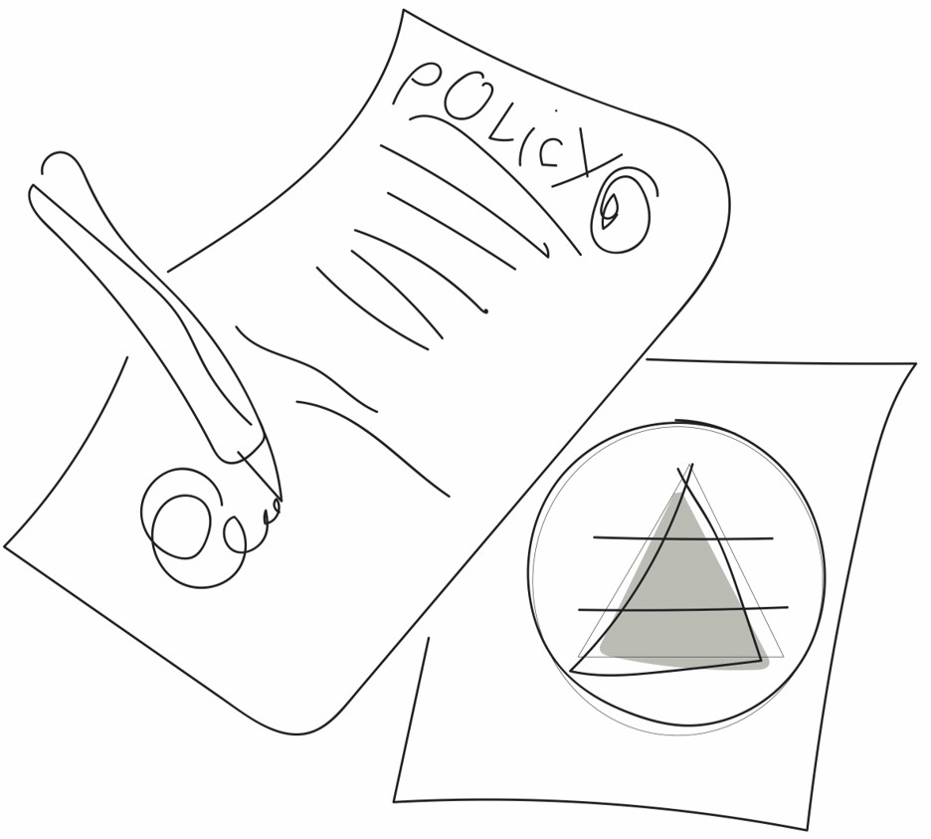
The Policy
  Enhanced Movement response
  to MHPSS needs
  Ensure quality
  Provide overall guidance
MHPSS needs addressed
in accordance with:
  Mandate and role
  Needs and gaps identified
  Resources, capacities and expertise
https://youtu.be/-I_12qZd4gM
Notes:
SLIDE 5. Purpose of slide: i) Restate the purpose of the policy, and ii) Explain the policy more deeply
Video Option: You may wish to show a 2 ½ minute video explaining the policy. It is available in the four languages of the IFRC:
Arabic: https://youtu.be/eaNuU44TCHM
English: https://youtu.be/-I_12qZd4gM
French: https://youtu.be/3jrgzGlt0yE
Spanish: https://youtu.be/kNFXSRsT5Uw
Speaking notes [You may wish to also directly mention by your own National Society by name]
As already mentioned, the purpose of the policy is to contribute to an enhanced Movement response to mental health and psychosocial needs. It seeks to ensure quality and provides overall guidance.
The policy helps the components of the Movement (National Societies, the IFRC and ICRC) to work more efficiently together and more coherently to ensure quality MHPSS services around the world.
Through the policy, the Movement [including our own National Society], commits to provide basic psychosocial support and to integrate MHPSS in all its humanitarian activities.
This also includes a commitment to building the Movement’s [and our own National Society’s] capacity to assess and identify needs, to refer clients to suitable services, and to advocate in relation to the full spectrum of mental health and psychosocial support needs.
All National Societies, [including our own National Society], the IFRC and the ICRC each have responsibilities to address mental health and psychosocial needs. These are defined in accordance with:
their mandate and role
the needs and gaps identified in the specific contexts in which they are working, and
their resources, capacities and expertise

Slide 6
The eight policy statements
  Ensure impartial access to mental
  health and psychosocial support and prioritize prevention and early response
  Ensure comprehensive and integrated support and care for people with mental health and psychosocial needs
  Recognize the resilience, participation
  and diversity of people in all mental
  health and psychosocial activities
  Ensure protection of safety, dignity
  and rights
  Address stigma, exclusion and discrimination
  Implement and contribute to the development of interventions based on mental health and psychosocial support standards and practices that are internationally recognized and informed
  by evidence
  Protect the mental health and psychosocial wellbeing of staff and volunteers
  Develop mental health and psychosocial support capacity
https://pscentre.org/movement-resource-room-mhpss-policy-and-resolution/
Notes:
SLIDE 6. Purpose of slide: i) Dive into the content of the eight policy statements
Speaking notes. Two options of presenting this slide are offered.
A practical exercise
A verbal presentation
Let’s go a little deeper into the content of the eight policy statements. The eight policy statements act as a guide to how the Movement should be providing mental health and psychosocial support in all contexts to affected populations, including staff and volunteers.
(Option 1. A practical exercise)
Instructions:
Show where the policy can be found either on the PS Centre website in Arabic, English, French, Spanish https://pscentre.org/movement-resource-room-mhpss-policy-and-resolution/, or on your own National Society website if it is there)
Give participants the full text of the eight statements from the policy, including the detailed guidance text.
Put participants into groups. Give them the following instructions: “I’m going to ask you to discuss in pairs or small groups one of the policy statements in detail. After 5 minutes, I am going to ask you to describe this policy statement in your own words to the plenary.” (you may also wish to ask them to provide an example of this policy statement in action)
After 5 minutes, bring the group back together and ask each group to very briefly state the policy statement in their own words.
(Option 2. A verbal presentation. Adapt text to your speaking style. You may wish to add examples of the policy statements in action in your National Society).
Instructions:
Use the below numbered text to explain each policy statement briefly.
Show where the policy can be found either on the PS Centre website in Arabic, English, French, Spanish https://pscentre.org/movement-resource-room-mhpss-policy-and-resolution/, or on your own National Society website if it is there)
Ensure impartial access to mental health and psychosocial support and prioritize prevention and early response. The Movement always responds to mental health and psychosocial needs based on and in accordance with the Fundamental Principles.
Ensure comprehensive and integrated support and care for people with mental health and psychosocial needs. Mental health and psychosocial needs vary greatly and have many different factors associated with them. A comprehensive, multi-layered approach is therefore recommended in promoting mental health and psychosocial wellbeing. This includes basic psychosocial support, focused psychosocial support, psychological support and specialized mental health care.
Recognize the resilience, participation and diversity of people in all mental health and psychosocial activities. The participation of people with mental health and psychosocial needs in response activities strengthens community engagement and accountability, mitigates the risk of doing harm and ensures that support is provided in a context-specific and culturally sensitive manner.
Ensure protection of safety, dignity and rights. Failure to ensure people’s safety, dignity and rights may cause great mental health and psychosocial concerns and increase existing vulnerabilities. Through protection activities, the components of the Movement can contribute to preventing or limiting exposure to risk and ensure that services do no harm.
Address stigma, exclusion and discrimination. People with mental health and psychosocial needs often face stigma and discrimination, which can sometimes have severe consequences for their safety, health and dignity, exclude them from society and prevent them from accessing assistance and protection. By addressing stigma and marginalization, we help to prevent further harm and promote dignity, inclusion and non-discrimination.
Implement and contribute to the development of interventions based on mental health and psychosocial support standards and practices that are internationally recognized and informed by evidence. As mental health and psychosocial support often involves highly sensitive issues, well-intentioned but ill-informed action has the potential to cause harm. By applying and contributing to evidence-informed mental health and psychosocial support and ensuring that all staff and volunteers responding to mental health and psychosocial support needs are regularly trained, supervised and equipped, we reduce the risks of doing harm and ensure dignity and quality in the services delivered.
Protect the mental health and psychosocial wellbeing of staff and volunteers. The mental health and psychosocial wellbeing of staff and volunteers is often affected as they work in difficult and stressful environments and are exposed to highly distressing experiences owing to the nature of mental health and psychosocial support work. The Movement exercises its duty of care and, in doing so, we not only promote the safety, health and wellbeing of staff and volunteers, but also ensure the quality of the services we provide.
Develop mental health and psychosocial support capacity. Human resources are the most valuable asset of mental health and psychosocial support services. These services rely on the capacity, competence and motivation of staff and volunteers. The Movement will contribute to building sustainable mental health and psychosocial support systems by strengthening its mental health and psychosocial support capacity and partnering with public authorities and other stakeholders.

Slide 7
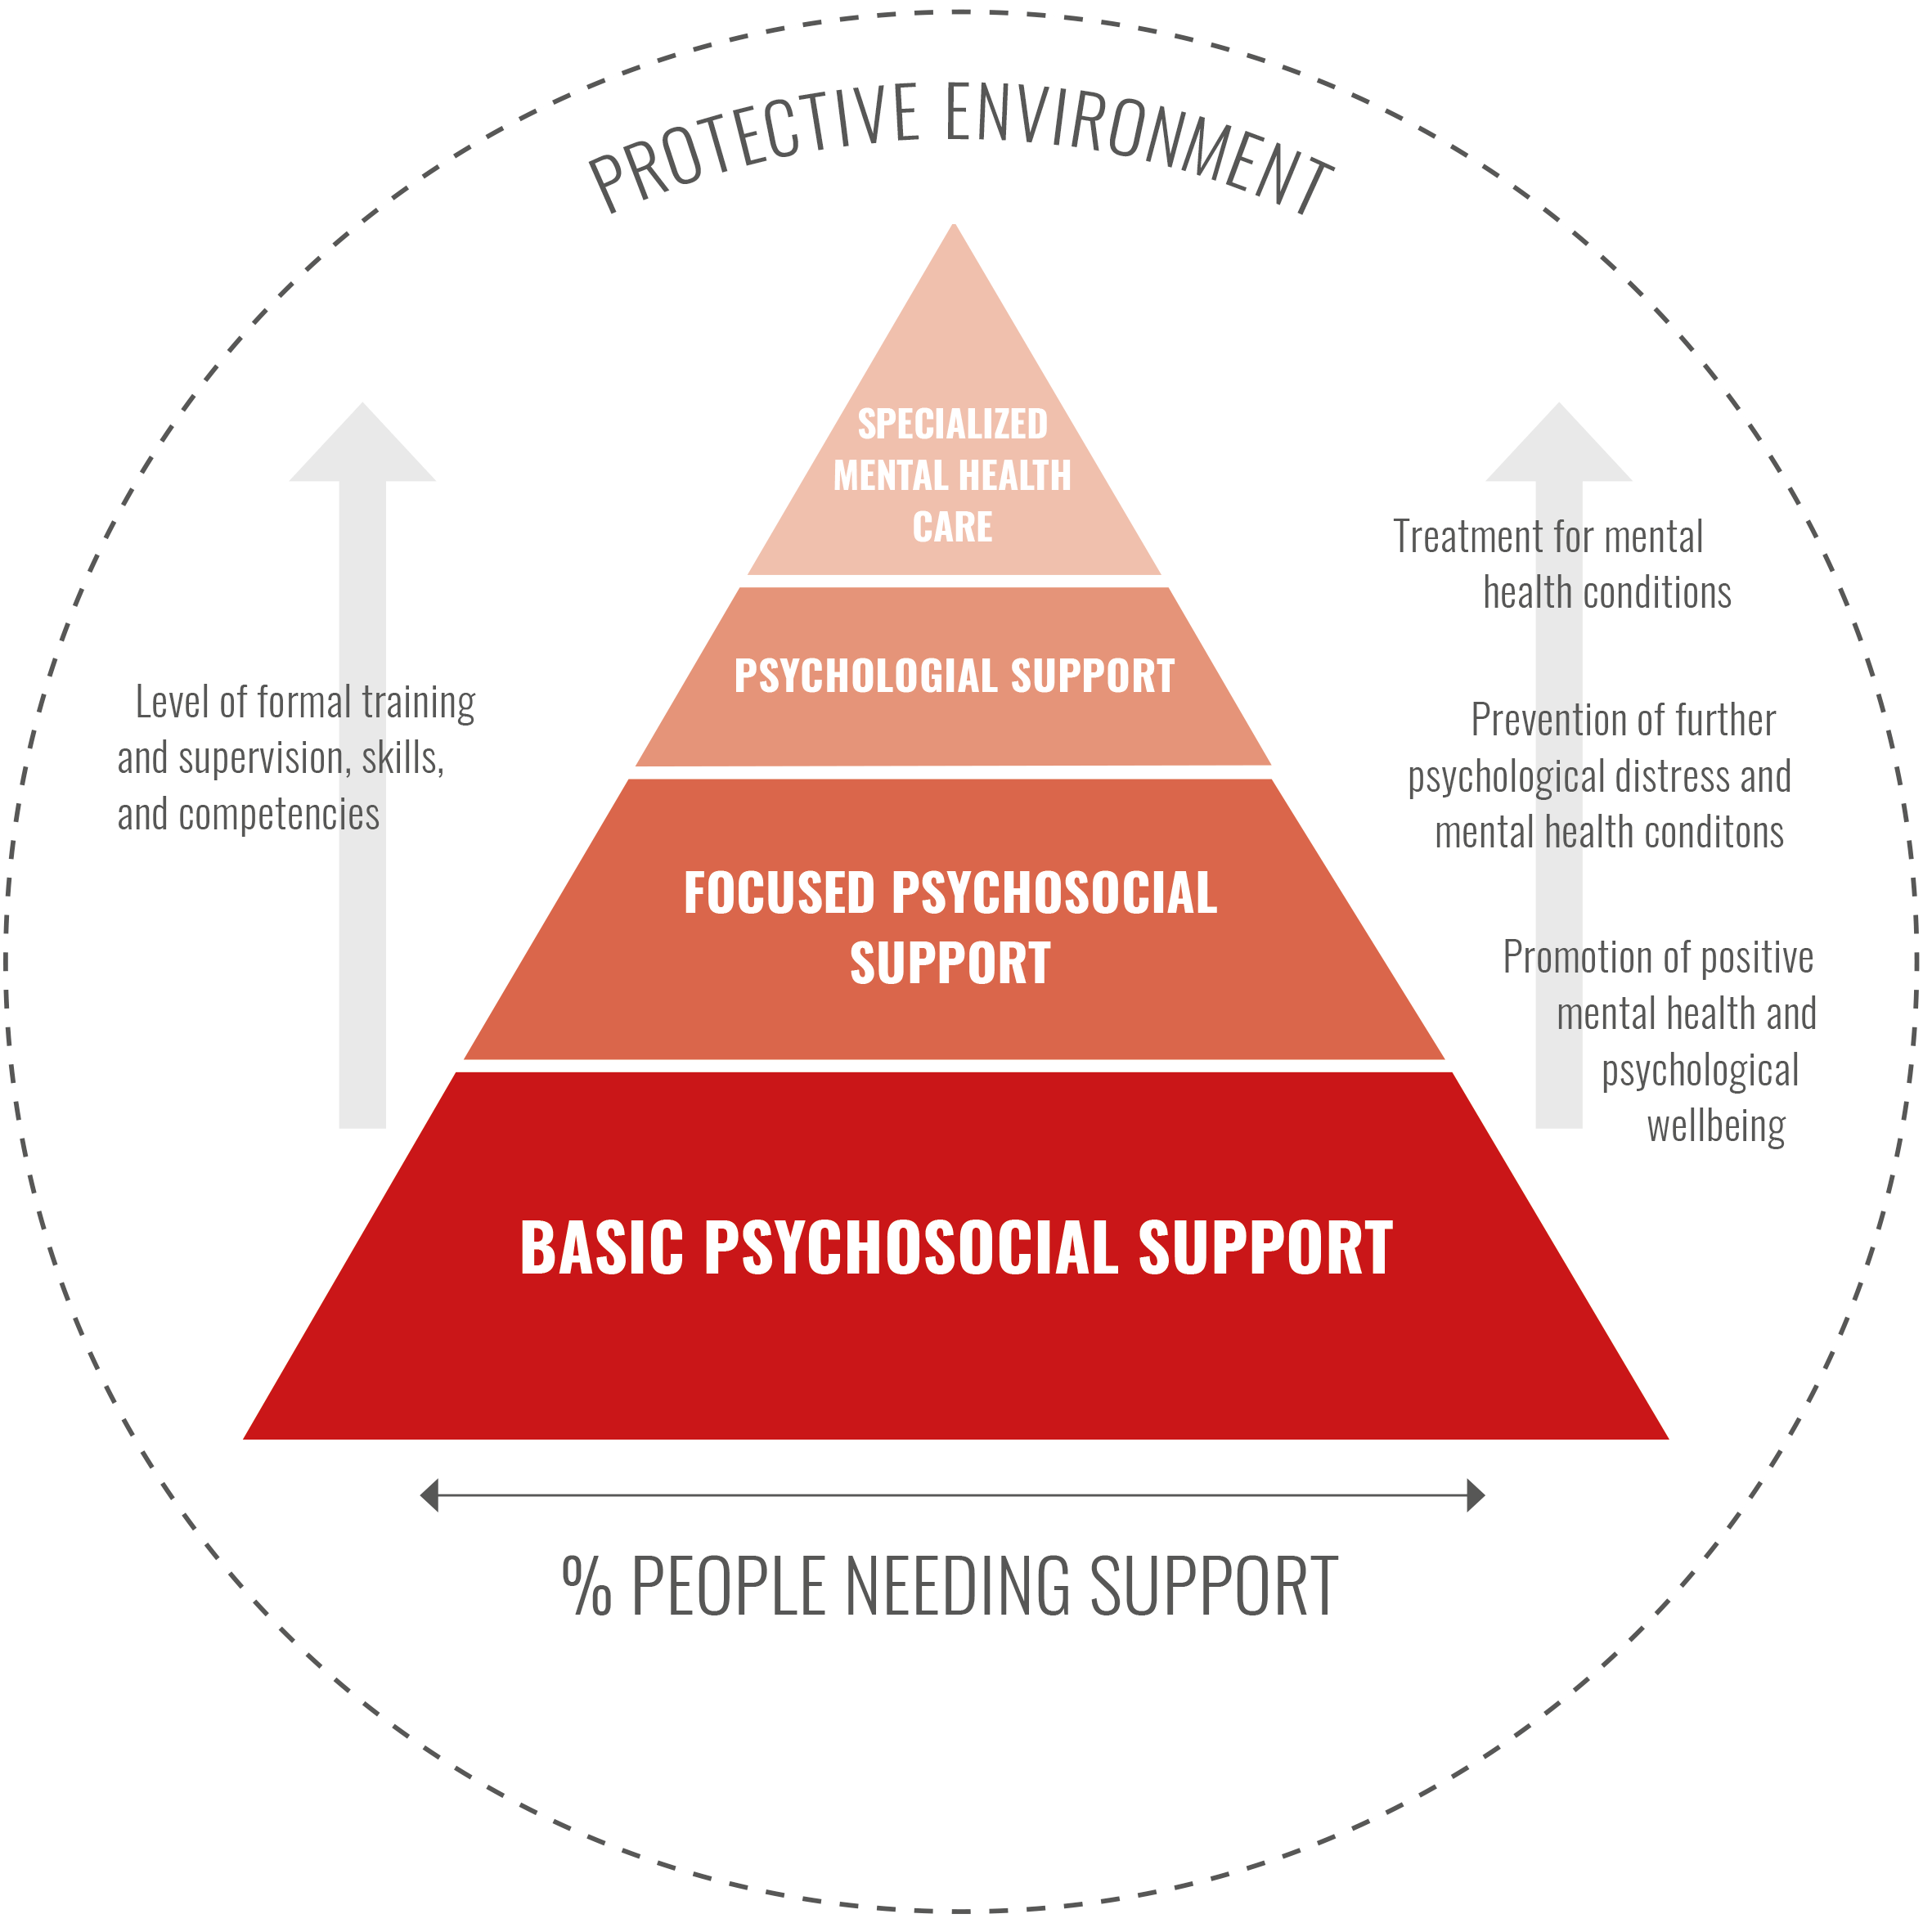
The Movement MHPSS framework
  4 layers, and a protective circle
  Focus on skills and supervision
  All National Societies, the IFRC and
  ICRC need to be able to:
    Assess needs
    Advocate for MHPSS
    Refer to suitable services
https://youtu.be/QUoLiPAAP4M
Notes:
SLIDE 7. Purpose of slide: i) Briefly explain the MHPSS framework
Video options:
It is suggested to show a video, made by and for the Movement, that explains the MHPSS framework. Two video options are available. Option 1 is a basic video that is 2 ½ minutes long. Option 2 is more detailed and possibly more relatable as it contains case examples. It is 12 minutes long. Both are available subtitled in four languages of the IFRC:
Arabic:
Option 1: https://youtu.be/L-T3sj2Y6Hk
Option 2: https://youtu.be/jV8Sc552g1Q
English:
Option 1: https://youtu.be/zAHD8CEWuXU
Option 2: https://youtu.be/QUoLiPAAP4M
French:
Option 1: https://youtu.be/Nid7E15Uay0
Option2: https://youtu.be/AZjo2zhDkcM
Spanish:
Option 1: https://youtu.be/kSHekOK0drE
Option2: https://youtu.be/e_bkzT67W3g
Speaking notes. These serve as an introduction to either of the video options. They are not detailed enough as a standalone description of the MHPSS Framework.
As I already mentioned, all National Societies, the IFRC and the ICRC respond to mental health and psychosocial needs in accordance with their respective roles and mandate. And while each response or role may be different, what is unifying is the way MHPSS support is organised.
The MHPSS Framework model illustrated on this slide represents the framework of services that are required to address the needs of individuals, families and communities in all contexts.
As you can see, the MHPSS Framework is comprised of 4 layers, and a protective circle. It also has a focus on ensuring that the right level of skills and supervision are provided to offer quality services.
A key to organizing mental health and psychosocial support is to develop a layered system of complementary support that meets the needs of different groups. This multi-layered approach does not imply that all Movement components must provide services in all layers.
However, all Movement components are expected to assess, refer and advocate in relation to the full spectrum of mental health and psychosocial support presented in the model, (from basic psychosocial support through to specialized mental health care).
Now we are going to watch a short video that explains the MHPSS Framework in more detail.
Show one of the video options listed on this slide
After the video, you may wish to also do a practical exercise and ask the audience to discuss some examples of their work, where they would sit on the framework, and ask if suitable training and supervision is currently being provided.

Slide 8
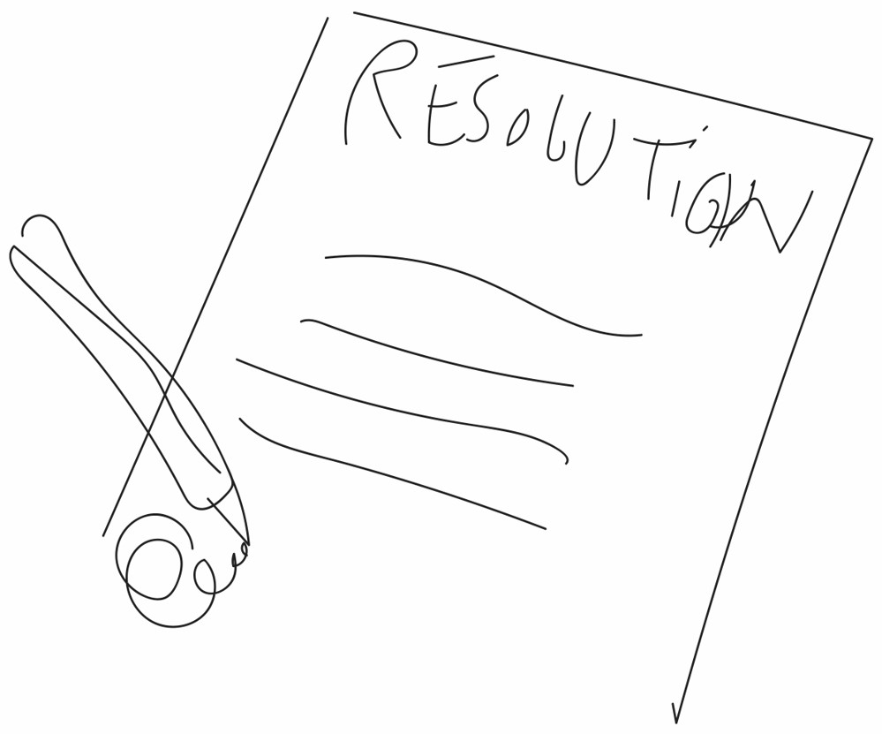
The Resolution
  Signed by 196 State Parties to the
  Geneva Conventions
  Call for joint and cohesive action
  between States, the Movement and
  other stakeholders
  For the context of people affected
  by armed conflict, natural disasters and other emergencies
  MHPSS needs often increase
  in these situations
Notes:
SLIDE 8. Purpose of slide: i) Restate who the resolution is for, and ii) Explain the purpose of the resolution
Speaking notes. Adapt to your context.
As already noted, the resolution is focused only on the context of people affected by armed conflicts, natural disasters and other emergencies. This includes the needs of migrants, refugees and internally displaced persons.
The resolution has been signed by all 196 States party to the Geneva conventions, all National Societies, the IFRC and the ICRC.
It is a call for joint and cohesive efforts between the Movement, States and other stakeholders to address critical gaps in mental health and psychosocial care, and it underscores the urgent demand to increase efforts to respond to these needs by means of prevention, promotion, protection and assistance.
While States have the primary responsibility to respond to the mental health and psychosocial needs of people in their territory. The Movement have important complementary and supportive roles, including through the auxiliary role of National Societies.
Mental health and psychosocial needs increase dramatically as a result of armed conflicts, natural disasters and other emergencies. This is due to many factors including:
People may be exposed to extremely distressing experiences, such as separation from or loss of loved ones, loss of property and livelihoods and severe violations of human dignity, including sexual and gender-based violence, torture and other forms of ill-treatment.
These experiences often take place repeatedly over many years, as emergencies grow in complexity and duration. As a result, pre-existing mental health conditions may resurface or be exacerbated, and other mental health conditions can arise as a direct consequence of these experiences.
Social and community support systems erode, and material resources that affected people need for coping and recovery are damaged or destroyed.
Many people are forced to leave their homes, which is often accompanied by the disruption of social connections, a lack of information, uncertainty about immigration status and policies, hostility and undignified and protracted detention, all of which add additional stress.

Slide 9
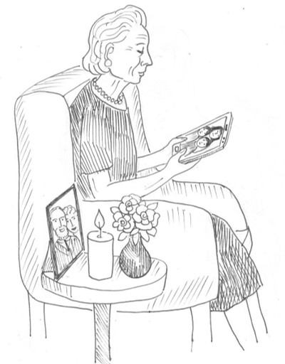
The Resolution
  Ensure early and sustained access to mental
  health and psychosocial support for emergency
  affected populations
  Increase local and community-based action and the cooperation between National Societies and States
  Ensure that responses are comprehensive and
  include psychosocial, psychological and
  specialized mental health care
  Integrate mental health and psychosocial support
  into all activities addressing humanitarian needs
  such as health care, education and protection
  Strengthen the mental health and psychosocial workforce, including volunteers
  Address stigma, exclusion and discrimination
  Protect the mental health and psychosocial
  wellbeing of staff and volunteers
https://youtu.be/ci2XnEaV5AM
Notes:
SLIDE 9. Purpose of slide: i) Go deeper into the content of the resolution
Video option
You may wish to show a video about the resolution instead of using the speaking notes. It is available in the 4 languages of the IFRC:
Arabic: https://youtu.be/D21DAufSYfo
English: https://youtu.be/ci2XnEaV5AM
French: https://youtu.be/h0oB3vR_CiY
Spanish: https://youtu.be/N3TOZvmRzo0
Speaking notes
Specifically, the resolution calls upon States, National Societies, IFRC and ICRC to increase efforts to:
ensure early and sustained access to mental health and psychosocial support services by people affected by armed conflicts, natural disasters and other emergencies;
Invest in local and community-based action and enhance cooperation between national societies and States;
Ensure that mental health and psychosocial support responses include psychosocial, psychological and specialized mental health care;
Integrate mental health and psychosocial support into all activities addressing humanitarian needs, including prevention and protection, and ensure that mental health and psychosocial support and responses addressing other humanitarian needs, such as shelter, food, livelihoods, education and support to separated families and families of the missing, are mutually reinforcing;
Strengthen the quality and capacity of the workforce, including volunteers, responding to the mental health and psychosocial needs of people affected by armed conflicts, natural disasters and other emergencies, in close coordination and cooperation with the components of the Movement;
Address stigma, exclusion and discrimination related to mental health and psychosocial needs through approaches that respect the dignity and reinforce the participation of affected people, in particular persons with lived experiences, in a context-specific, culturally and faith-sensitive way;
Protect and promote the mental health and psychosocial well-being of staff and volunteers who are responding to humanitarian needs across all sectors, equipping them with the necessary skills, tools and supervision to cope with stressful situations and responding to their specific mental health and psychosocial needs.

Slide 10
A roadmap for implementation 2020–2023
Priority action areas:
  Guarantee a basic level of psychosocial
  support and integrate mental health and
  psychosocial support across sectors
  Develop a holistic MHPSS approach
  between Movement components and in
  collaboration with other actors
  Protect and promote the mental health
  and psychosocial well-being of staff and
  volunteers
  Demonstrate the impact of MHPSS
  interventions through research, evidence,
  monitoring and evaluation
  Strengthen resource mobilization for
  MHPSS in humanitarian response
  Mobilize political support for MHPSS
  – humanitarian diplomacy and advocacy
By the end of 2023, the expected outcomes are:
  A basic level of psychosocial support is established in National
  Societies, the IFRC and the ICRC, and MHPSS considerations
  are integrated into other key humanitarian services
  Access to quality MHPSS services across the Movement’s
  MHPSS framework2 has increased in selected
  operational contexts
  A supportive and caring working
  environment is achieved and sustained
  across the Movement
  The impact of MHPSS interventions
  and innovative approaches is documented more widely
  The Movement’s financial resources for MHPSS have increased
  in line with funding targets defined in a Movement resource
  mobilization strategy for MHPSS
  The commitments set out in resolution 2 are reflected in
  national and international policy and legal frameworks
Notes:
SLIDE 10. Purpose of slide: i) Introduce the roadmap and explain its purpose and focus areas
Speaking notes
In 2020, a joint roadmap was developed by the IFRC, the ICRC and National Societies as a way forward for the Movement to implement the policy and resolution.
The roadmap supports a strategic and coordinated approach to implementation of the policy and resolution and identifies six priority action areas – as shown on the PowerPoint slide. These areas were selected as areas on which all Movement components could work and show collective impact and highlight MHPSS as part of our core identify and brand.
It sets out key activities for National Societies, IFRC and ICRC and for the Movement as a whole and outlines the outputs and outcomes expected by 2023.
The roadmap is not intended as a standalone document but should be read together with the policy and resolution.
IFRC, ICRC and National Societies are supporting and coordinating the rollout of the roadmap through 6 working groups – one for each priority action area.
Enquires to join a working group can be sent to the IFRC Reference Centre for Psychosocial Support at psychosocial.centre@ifrc.org who will then redirect your enquiry to the correct working group lead.

Slide 11
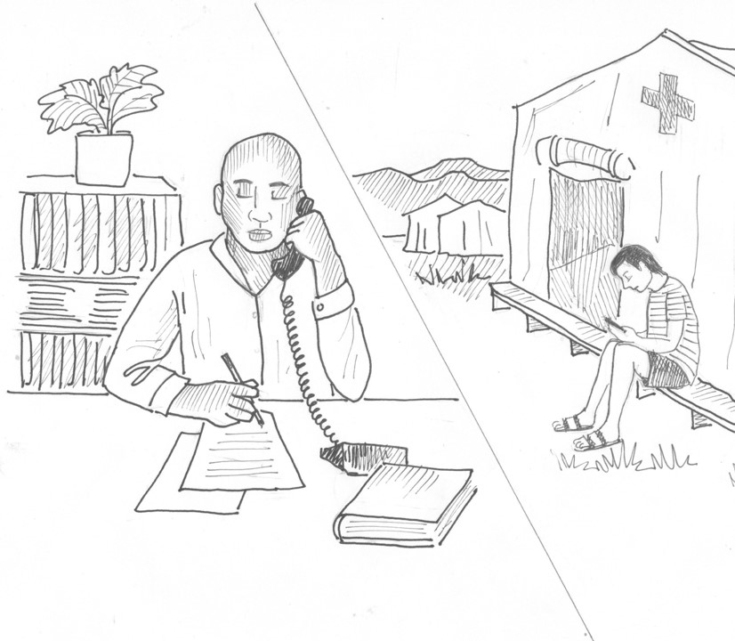
Resources
ICRC MHPSS Guidelines
(Arabic, English, French,
Portuguese, Spanish)
IFRC Reference Centre for
Psychosocial Support (PS
Centre) at pscentre.org
PS Centre website. Search
for ‘Resource Room’ on the
PS Centre website
Notes:
SLIDE 11. Purpose of slide: i) Provide link to resources on the policy, resolution and roadmap
Speaking notes
Before concluding our discussion today, I wanted to bring your attention to where you can find more resources for programming in MHPSS and on the policy and resolution.
ICRC MHPSS Guidelines (in English, French, Portuguese, Arabic and Spanish) can be found at this web address: https://www.icrc.org/en/publication/4311-guidelines-mental-health-and-psychosocial-support or by doing an internet search
The policy and the resolution can be found on the IFRC PS Centre website, either by going to the home page and using the search engine (click the magnifying glass)
Also the IFRC PS Centre hosts a webpage dedicated to resources that will assist in the implementation of the MHPSS policy, resolution and roadmap. Many of the videos shown today are on this website, along with key reference documents, podcasts, webinars and more that all support the implementation of the policy, resolution and roadmap. It can be found here: https://pscentre.org/movement-resource-room-mhpss-policy-and-resolution/
Thank you for your attention and I am happy to take any questions.

